Slide 1
Building the Bridge of Effective Communication
“Whether the communication is written or verbal, formal or informal, the question must be asked as to whether or not it was effective." - Carl Pritchard

Slide 2
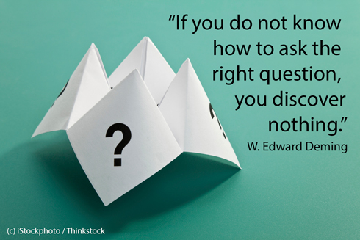
Why share analytical information?
“Not everything that can be counted counts, and not everything that counts can be counted.” - Albert Einstein, Physicist
Data is important, but the RIGHT data is critical.
You must ask questions and learn, be inquisitive
Most are comfortable asking questions of the data
Ask questions of the people using the data!

Slide 3

Why share analytical information?
“A point of view can be a dangerous luxury when substituted for insight and understanding.” - Marshall McLuhan, Canadian Communications Professor
Use data to enhance opinions
Data backs up and communicates what is not obvious
“I never guess. It is a capital mistake to theorize before one has data. Insensibly one begins to twist facts to suit theories, instead of theories to suit facts.” - Sir Arthur Conan Doyle, Author of Sherlock Holmes stories

Slide 4


Two Critical Components
Emotional Impact

Slide 5

Information Sharing
Beginnings / Endings – keep others informed on your status
Changes – early communication is best for good or bad changes
Developing Needs – be direct, plan ahead – why are you making requests?
Prioritization – manages workload of you and others effectively
Deadlines – provide this info willingly, less stress overall

Slide 6
WHO do you share the Info with?
Identify Who You Communicate with
Does it impact their work?
Do they influence funding/resources?
Who is in your network?
Eliminate “nobody told me” and be inclusive
Often an negative emotional response comes from being left out though not necessary
Avoid Blindsiding
Choose Your Words / Jargon
Put information in the language of the RECIEVER
Avoid “fancy words” or acronyms with anyone outside of your department or team that you work closely with on the same projects
Your jargon can be meaningless or overwhelming to those without the same vocabulary

Slide 7
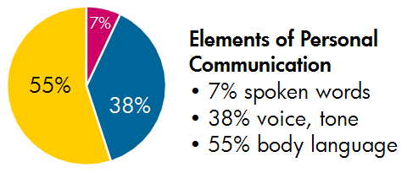
It’s what you say, and how you say it!
TONE: often an underestimated importance to analytics professionals
PACE: best to match the person you’re speaking to without mimicking to the point of mocking
WORDS: in a complex profession your words are very important, with clear meanings.
Others will not be as familiar with all the words you use or their specific meaning
EXAMPLE:
What are you doing here?
What are YOU doing here?
What are you doing HERE?
Dr. Albert Mehrabian’s Research

Slide 8
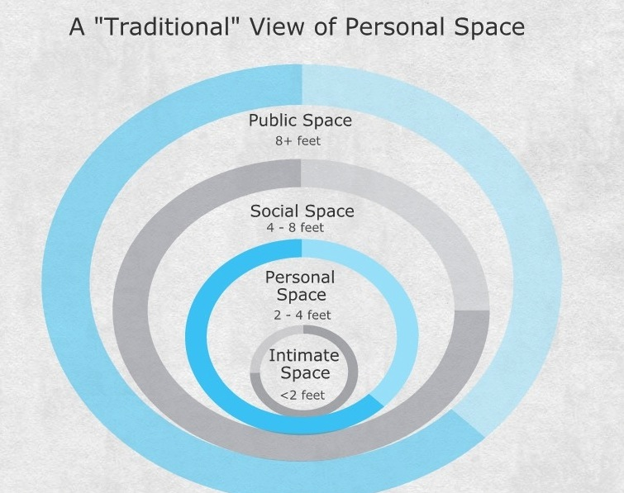
It’s what and how you don’t say it!
Non-Verbal
Sometimes subconscious communication
You don’t have to say everything you’re thinking to still communicate
Eye Contact
Best: consistent, intermittent contact
Worst: no eye contact or starring
Physical Spacing
Varies depending on the person, circumstances, external factors
Don’t crowd, but don’t disconnect

Slide 9

Body Language
There are some blatant/overt meanings to body language and others that are presumed
What you intend to say doesn’t really matter, it’s what your receiver thinks you’re saying
As you observe others pay close attention to changes or transitions in their body language especially in response to something you’ve said

Slide 10
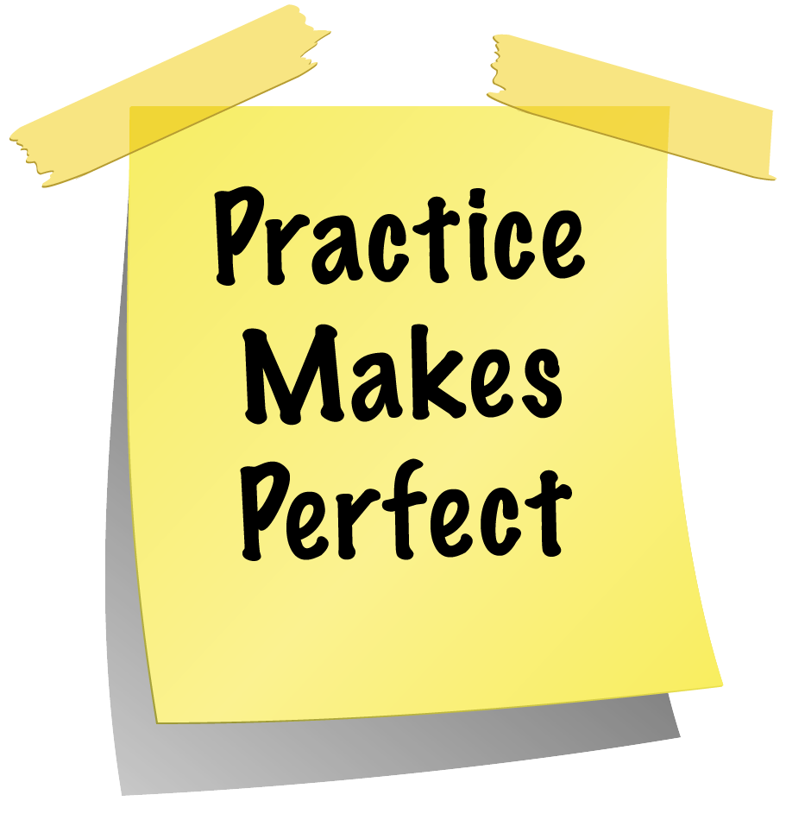
In conclusion
Pay just as much attention to HOW you convey your communication as you do your actual content
Before communicating practice – many elements can effect you even if well prepared
Video record yourself if possible to bring awareness to other parts of your communication which need improvement

Slide 11

Successful Presentations
“If you can’t explain it simply, you don’t understand it well enough.” - Albert Einstein, Physicist

Slide 12
Presentation Basics
Be to the point, avoid sentences
Don’t clutter the slide
Use a LARGE FONT
Keep logo in same place
Use color to draw out a point
Pictures help
Don’t read like a teleprompter
Be ready to skip slides
Never turn your back to audience

Slide 13

Presentation Necessities
Title Page, Author(s)
Overview
Summary
Outline
Background
Results
Next Steps/Reco (if needed)
Q&A / Appendix, Backup Slides

Slide 14

Why give a presentation?
Be seen as a thought leader! What good is knowing something if you can’t communicate it to others, and well!
Strong skill worth developing no matter what job / career you go into!
Helps you sort out what you’ve done, why, how it helped, what you can teach others…

Slide 15

It’s about a story, not just information
Take your audience on a journey and guide the listener
Clearly identify the beginning / end to audience
Don’t set out to cover it all, what does the audience need to know about
Strike the balance between over-explaining or being too high-level

Slide 16

Presentation Mistakes
Don’t underestimate a good title to drive home the key point
Make sure the information shared is relevant!
Don’t loose your audience with too many details / numbers
Don’t forget to give attention to the aesthetics as much as the content
Don’t go overboard with transitions/animations just because you can
Try not to toggle in and out – distracting!
Don’t use a word if it throws you off.

Slide 17

Develop Your Delivery
Don’t read off the screen, it distracts the audience
Don’t memorize verbatim – you’ll sound robotic, unoriginal, recited
Pay attention to tone – audiences tune in or out based on tone solely
Best to be conversational – allows other to feel they can participate if they have a question or comment
Use a wireless slide advancer, 1 less distraction

Slide 18

Stage Presence
When we’re nervous most move too much or not enough, rarely look comfortable
Walk around if it feels natural, but don’t distract yourself
Use hand gestures if appropriate
Eye contact is powerful with select few
Engage the audience with Y/N questions
Don’t worry about being nervous, they expect you to be!

Slide 19

Before You Begin Speaking
Look like an expert, feel comfortable/confident in how you dress
Look around the room: equipment necessary, podium, light switch, door, microphone, someone to help with handouts…
Using Audio Visual Equipment? Make sure it’s set up and working
Have an emergency backup system – email yourself the presentation, and bring a flash drive

Slide 20
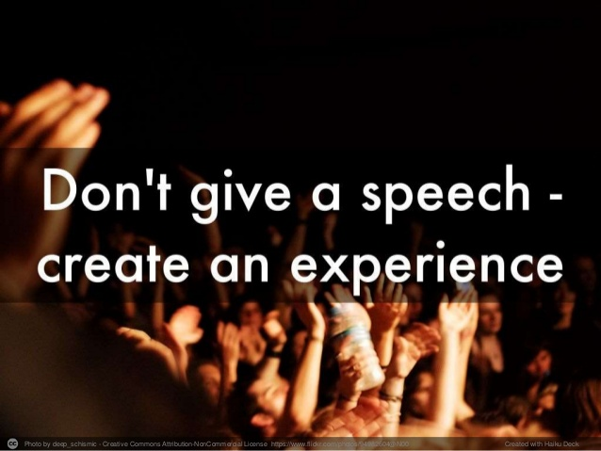
When You’re Speaking
Ask questions of the audience – get them engaged if your material allows for it so you can have more dialog
If your presentation has a lot of numbers and statistics then try not to read them all, audiences will tend to gloss over – you don’t want anyone to fall asleep!
Show, don’t tell the figures

Slide 21
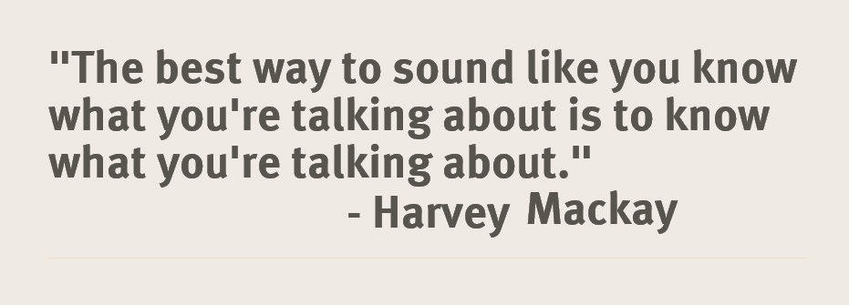
When You’re Speaking
Observe your audience, notice their responses – puzzled looks or nods?
Be ready to adapt if necessary!
Don’t talk too fast – we all tend to speed up our speech when we’re nervous
If you’re reading from projected slides or notecards in front of you make sure to look up and make eye contact

Slide 22

Powerful Phrases
When trying to drive home a point, “Three examples of this are…” (power of 3!)
Transitions help the audience follow along, “now let’s put that aside and move on”
“In conclusion” give your listeners the verbal cue that you’re wrapping up, PLAN YOUR FINISH

Slide 23
Questions?
Thank you!
THE END

Slide 24

Worried about presenting data?
A challenge for most analytical professionals
How to bring enthusiasm and energy to numbers?
Why should the audience care?
How will this help?
What is our potential with new information?
TED Talk: The Best Stats You’ve Ever Seen!

Slide 25
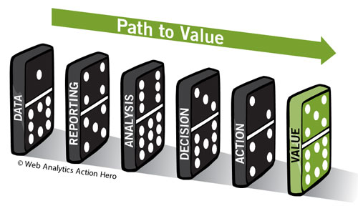
Present the what, and SO WHAT!
Don’t simply provide facts and figures
Draw out the solution to a problem?
Provide a call to action? AH HA!
Give clarity to complex problem?
What’s the big takeaway for audience?

Slide 26
BREAK

